Slide 1

Hadoop: Distributed Processing of Big Data
Lecture 01
Marilson Campos
UCSC Extension - 2022

Slide 2
About Me
Marilson Campos
Principal Data Architect with 15+ years of experience.
Background in Machine Learning and Search engines
Designing Big Data systems since 2007
- Some relevant presentations
Hadoop Summit 2013
Apache Impala User Group - 2015
Strata 2016 – Use case @ Cloudera Booth
Impala spotlight – Cloudera 2016

Slide 3
About the class What about you
Why you are taking this class?

Slide 4
About the class What we will cover
Big Data architecture and its components
Hadoop Map/Reduce model
Spark programing.
Big Data using Hive (SQL)
Extending Hive
Kafka & HBase
Data pipeline design

Slide 5



Recommended Books
Hive
Spark
SQL

Slide 6
About the class At the end of this class, I expect you to…
Have an intuition about Big Data system design.
Be able to write Big data programs.
Know how to design a “data pipeline”.
Continue to learn using other sources.

Slide 7
About the class Class Material vs The Test
We are covering some non-trivial concepts.
If you miss few advanced details, don’t worry too much. Important: If you are lost, please stop me! And ask for clarification.
I want to make the class as interactive as possible.
Problems in the labs are a lot harder than the ones in the test.
This is by design, so advanced students can also benefit from the class.
To succeed in the test, you need to master the foundational knowledge about a Hadoop cluster, Hive, and Spark.

Slide 8
Tests
Test 1 – After 5th Lecture (Take home)
8 questions worth 5 points each.
7 multiple choice questions
1 question with one paragraph answer.
Test 2 – At 8th Lecture - Open book.
4 questions worth 15 points each.
Test your knowledge on perform operations like:
Load file into a Hadoop cluster
Create a table mapping to files loaded.
Perform transformations on datasets.
Query and extract results from cluster.

Slide 9

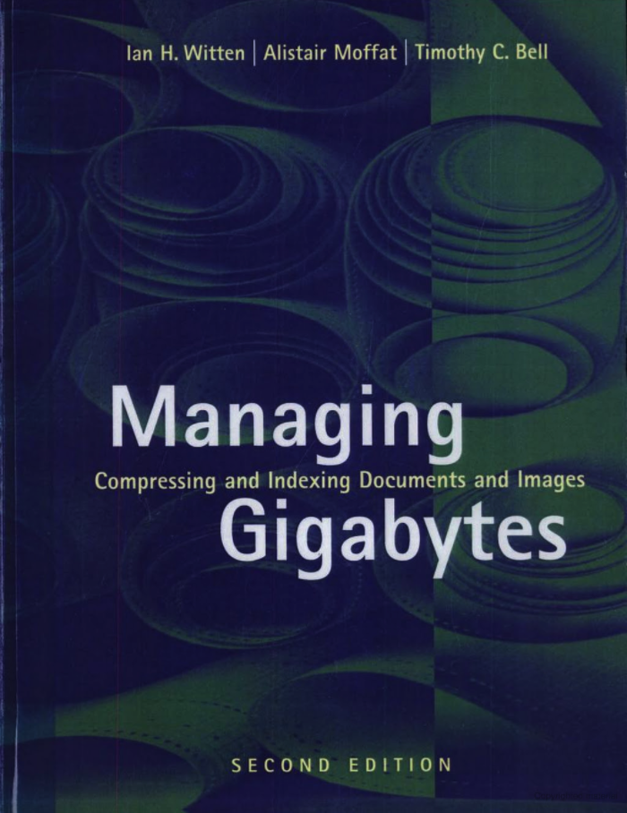
Big Data Why Big Data?
More information being stored digitally.
Need to process larger datasets and unstructured data.
Cannot process in traditional databases systems.
Published 1986
Published 1994

Slide 10
A New Architecture is needed Data Transfer versus Storage Size
1990
1Gb Storage
4Mb per second data transfer
Time to read all data = approx. 4 minutes
2019
4,000Gb Storage (~4Tb)
100Mb per second data transfer
Time to read all data = approx. 11 hours.

Slide 11
1Mb data transfer
Operation | X Speed factor
Processor Read | 1000 x
Memory Read | 120 x
SSD Read | 20 x
Disk Read | 1
Disk Seek | ½ x
1Gpbs Net | ½ x

Slide 12
Big Data The 5 V’s of Big Data
Variety
Different sources and representations of data
3
Velocity
Speed at which new data is being created
Veracity
How messy the data is. (Typos, errors, etc.)
2
4
Big
Data
Value
Ability to turn our data into value (should consider risks)
Volume
Sizes of datasets
1
5

Slide 13
A New Architecture is Needed High level abstraction
Inverse of Virtualization
Virtualization = one machine appears to be many.
Big Data = many machines appear to be one.

Slide 14
A New Architecture is Needed Forces
Represent large datasets
Distributed
Memory, disk or combination.
Process datasets
Use cluster resources to execute in parallel.
Handle failure
Automatically recover from failure.

Slide 15
A New Architecture is Needed Initial approach
Big Data distributed System
Many Computers processing in parallel.
Many disks available.
No transaction beyond files.
Single computers/disks should be able to fail with no impact.

Slide 16
Hadoop is born
The Hadoop Timeline
Hadoop 0.1
Terabyte 62s
Amazon
Elastic Map/Reduce
- Hadoop 0.1 released
- Sorts 1.8Tb in a 288 cluster in 48 hours.
- Yahoo-300 nodes cluster
- Yahoo! win TB in 62 secs. - 2nd Hadoop Summit - MapR is founded - Hadoop code base reorg
Cloud based solution disrupted the Big Data space
2003/4
2008
2014
2014-Present
2000
2018
2006
2009
2015-Present
Initial papers
Terabyte win
Apache Spark
Spark services
- Google file system paper published
- Map/Reduce : Simplified Data Processing on Large Clusters (2004)
- Cloudera is founded
- 1st Hadoop Summit - 20 companies on page "Powered by Hadoop"
- Spark promoted to top Level project.
- Hadoop Summit (San Jose) - Apache Hadoop 2.4
2.2 Available
- Databricks – Spark as a service over cloud.
- Integrated development environment using notebooks.
- Spark 3.0 (2020)

Slide 17
Hadoop is born Big Data Distributions
In premises ( Datacenter)
Cloudera
Most popular in premises
Hybrid cloud offerings
Hortonworks
Most portable (Compatible with Windows)
Merged with Cloudera
MapR
Based on custom Linux filesystem
Acquired by HP.
Cloud Based
Amazon Elastic Map/Reduce (EMR)
Cloud based simple to use
Current cloud-based leader.
Microsoft
Azure Big data
Part of Microsoft cloud offerings.
Google
Google compute engine
Part of Google other cloud offerings.

Slide 18
Hadoop is born The Hadoop Cluster
1000’s of servers running
Each with dozens of disks.
High chance of single failure.
Automated recovery
In case of a failure, the system needs to detect it and recover.
Cluster programs should not fail in this case.

Slide 19
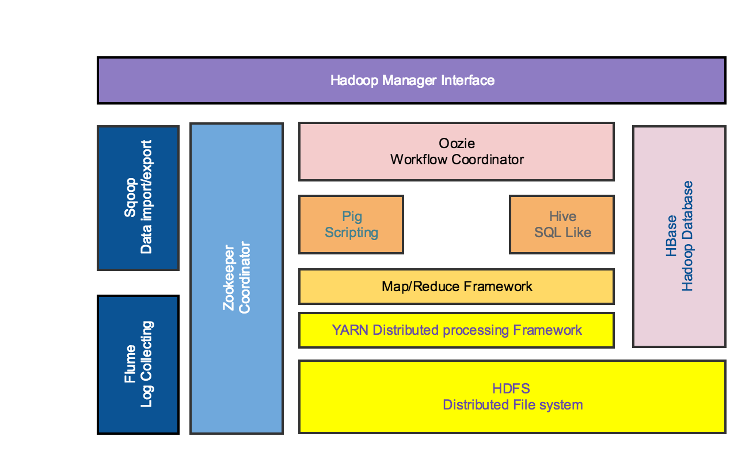
Hadoop is born The Hadoop Stack

Slide 20
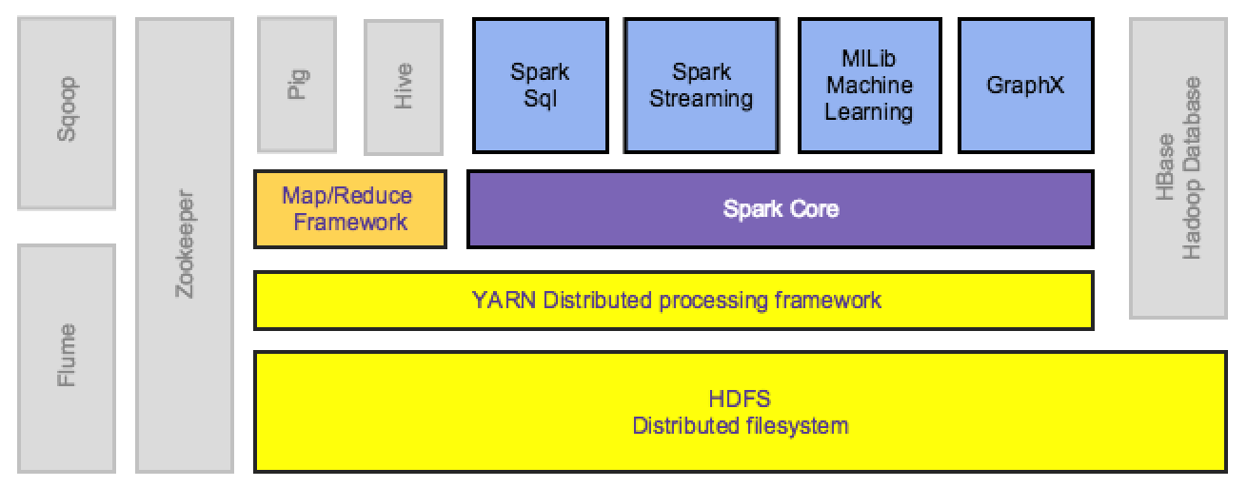
Hadoop is born The Hadoop/Spark Stack
Spark uses Hadoop core to execute jobs.
Spark uses HDFS for storage.

Slide 21
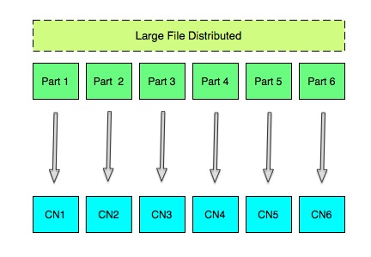
MapReduce Distributed execution v0.1 – pure map
Notes:
Mapping means break an input into parts and assign each input to a node.
Lets remember HDFS. A file is broken into blocks.
Each part is going to be equal to a block. Also, Remember that blocks are stored in several places ?
So during the map phase Hadoop is going to create a list of parts (blocks) and where is going to be executed.
Then is going to execute the plan describe on the list.
This list is optimized to move as less data as possible. Data locality concept.

Slide 22
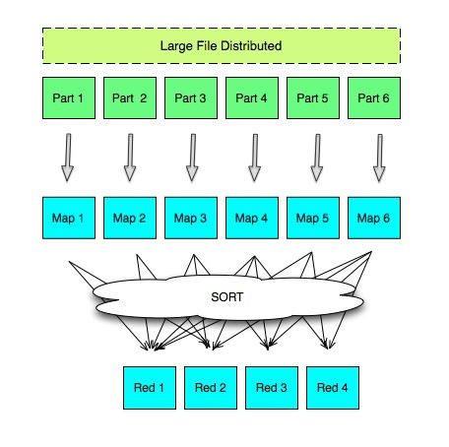
MapReduce Distributed execution v1 – map/reduce
Notes:
That what the reduce phase does.
It uses one key provided by the user to pack records together to be processed in one node on the reducer phase.
If this is a little confusing at the beginning be patient it will become clear when we solve problems with it.

Slide 23
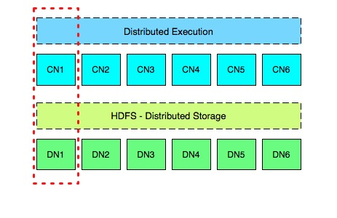
MapReduce Distributed execution – deployment
Notes:
On Node 1, There will be two types of workers one for HDFS and one for MapReduce.
The worker for HDFS is called DataNode.
The worker for MapReduce is called TaskTracker. The reason for this name is that a task in this context is running in one machine to process one part.
The task tracker is responsible to propagate information about the progress of that task to the Master.
Each node in the cluster defines a property for how many slots of tasks can be executed in parallel.
This number depends on the Hardware of the Node.
Ex. If I have machines with different capacity on the cluster, I can say on the bigger box allow 10 slots while the small box is running 6 slots.

Slide 24


Hadoop is born Hadoop Map/Reduce x Spark
Low level API
Designed for batch processing (slower starting time)
Long running process
Reads and writes data to and from disk many times.
Higher level API
Tries to use and keep data in memory.
Supports batch and near real-time.
(faster starting time)

Slide 25
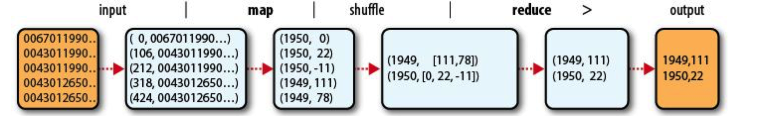
Hadoop Map/Reduce Map/Reduce processing
Data flow:
- Input
- Map (transformation)
- Shuffle (sort)
- Reduce
- Output

Slide 26
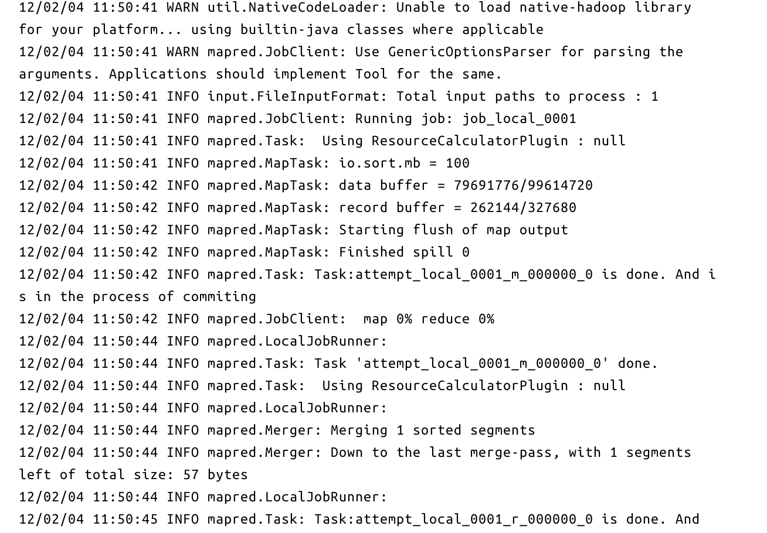
Hadoop Map/Reduce - Run output 1/2

Slide 27
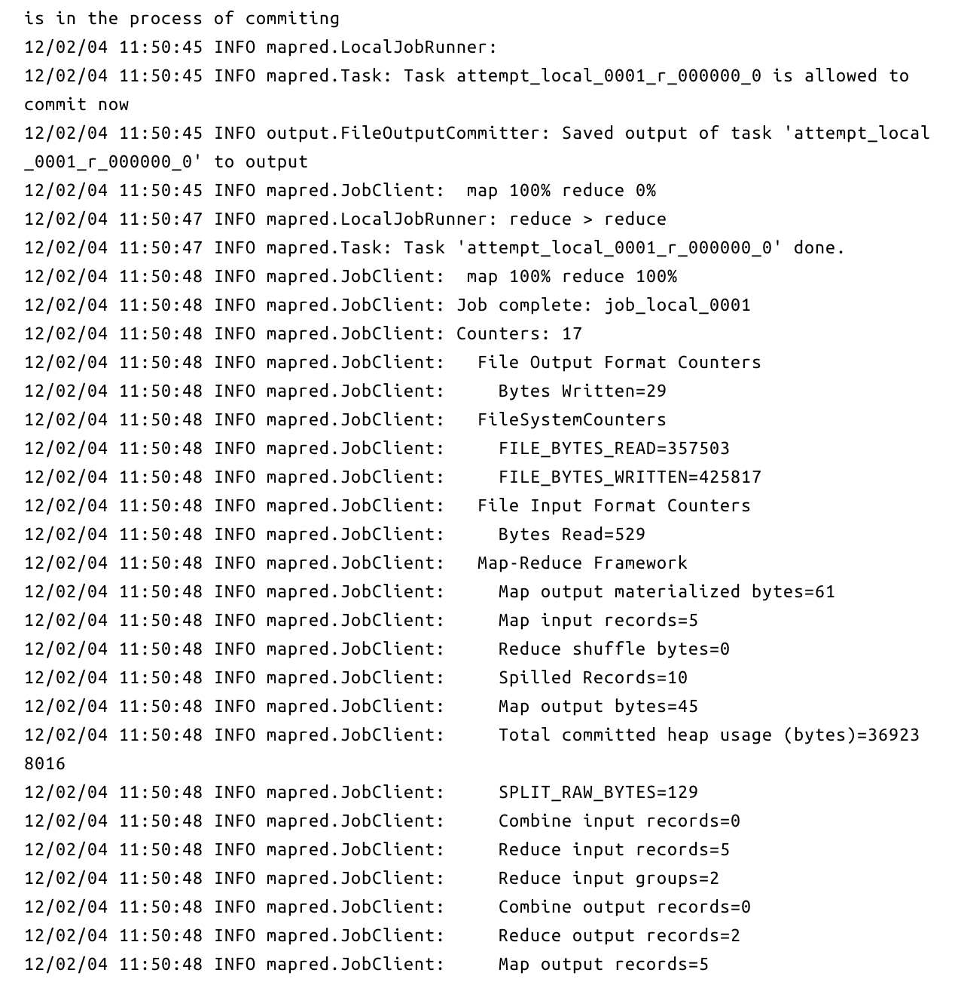
Hadoop Map/Reduce - Run output 2/2

Slide 28
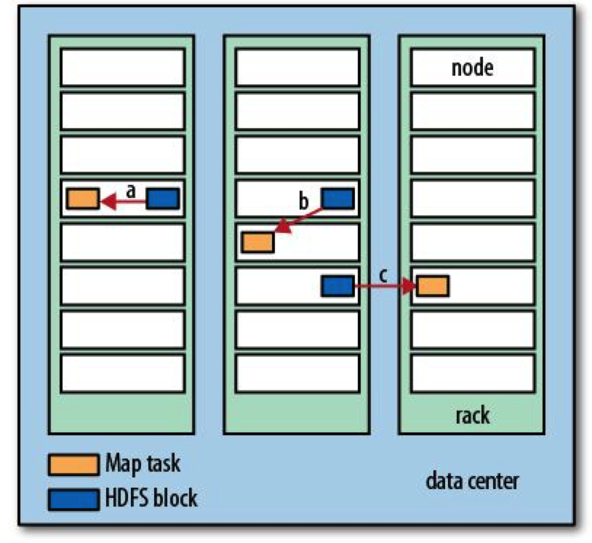
Hadoop Map/Reduce Send the code to the data!

Slide 29
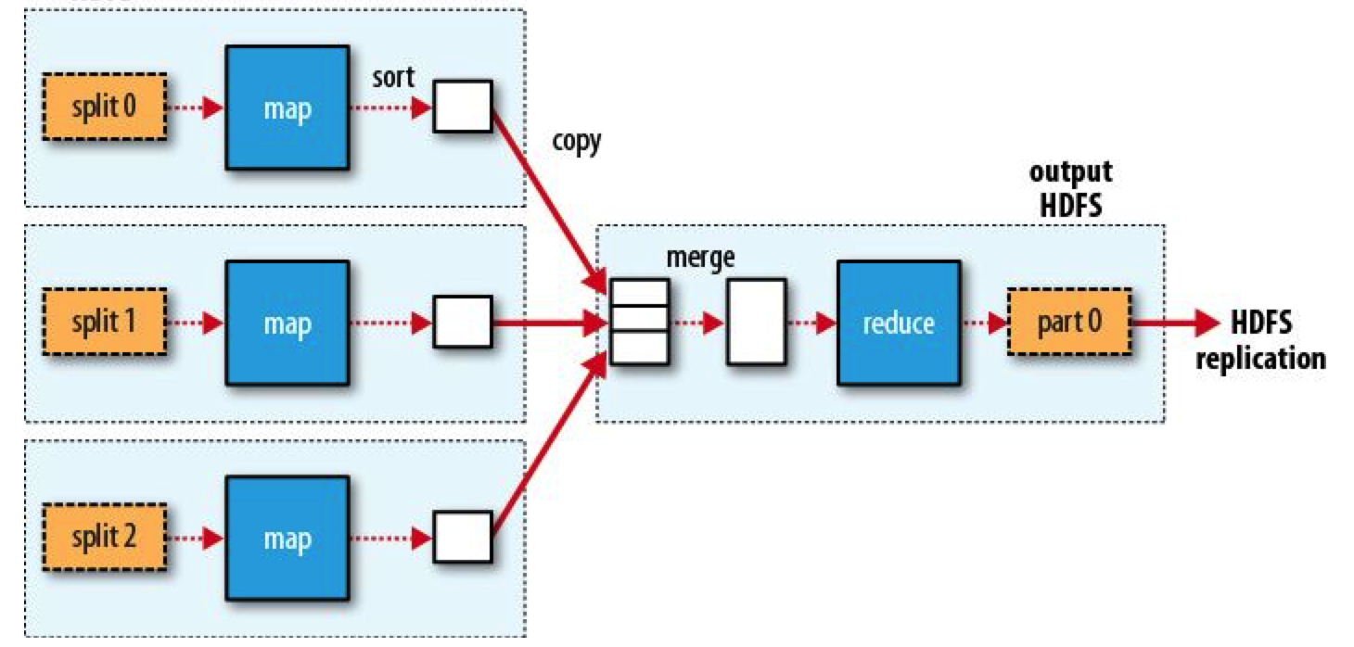
Hadoop Map/Reduce MR Splits and dataflow 1 reducer

Slide 30
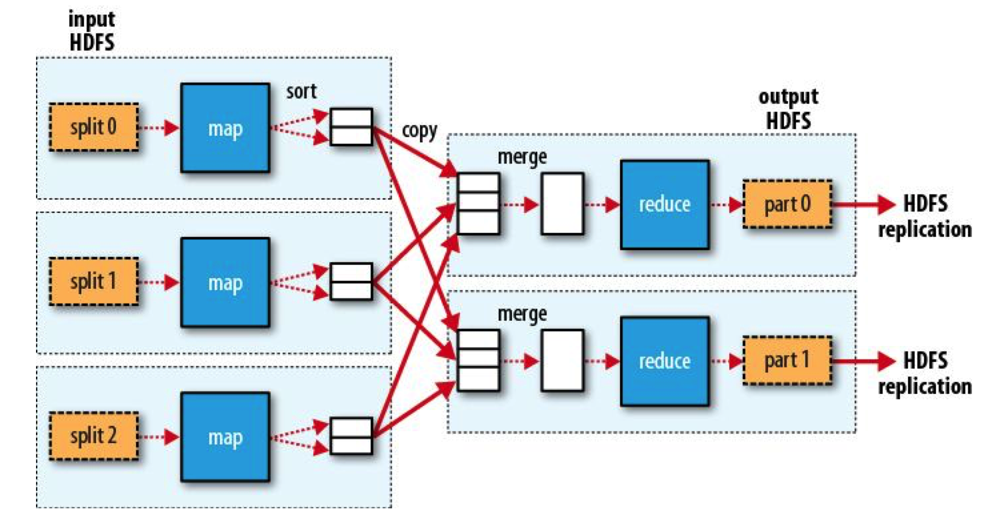
Hadoop Map/Reduce MR Splits and dataflow multiple reducers

Slide 31
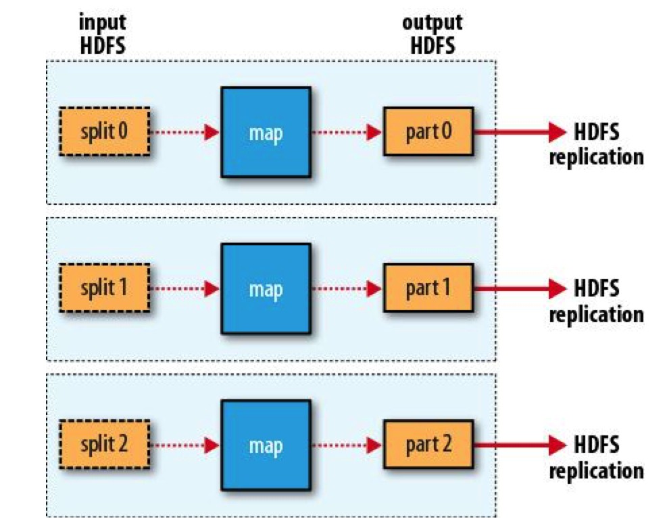
Hadoop Map/Reduce MR Splits and dataflow Zero reducers

Slide 32
Hadoop Map/Reduce The Combiner
Calculates Intermediary results
No guarantees if it will run or even how many times it will runs.
- Optimization feature

Slide 33
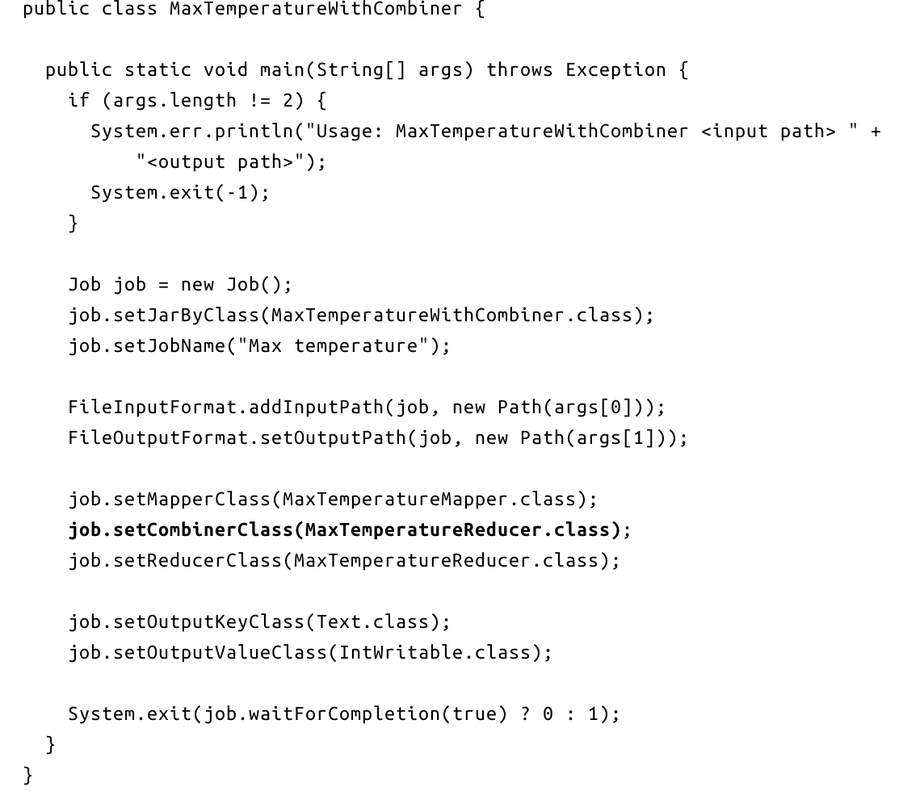
Hadoop Map/Reduce The Driver program

Slide 34
Hadoop Map/Reduce Different integrations
Map/Reduce Api -> JVM language (Java, Scala)
Hadoop M/R Streaming -> Unix Stdin/Stdout.
- Hadoop pipes -> Unix Sockets

Slide 35
HDFS – Hadoop File Systems Big Data Storage
Unix like filesystem
Access rights identical to Linux
- No support to updates
- Self healing capabilities.

Slide 36
HDFS – Hadoop File Systems Big Data Storage
Very large file support
Optimized for continuous ”reads”.
High throughput at the expense of latency
Train vs Ferrari
- Single writer, no support to multiple writers.

Slide 37
HDFS – Hadoop File Systems HDFS Concepts
Blocks
Atomic unit of storage
Namenode
the master daemon for storage
Stores the metadata
1 Active
1 Standby
Journal Nodes
Record changes on filesystem
Responsible for metadata updates on standby namenode.
Datanodes
Responsive for reading/writing data.

Slide 38
HDFS – Hadoop File Systems HDFS – Big Data Storage
Namenodes
Journal Nodes.
- Datanodes

Slide 39
Spark Spark lab Preparation
Signup for Databricks
Search for ‘Databricks Community Edition: Login’ and signup for the community edition.
Note: Do not create a trial account as it will expire and will require for you to pay for it.

Slide 40
Q & A

